Slide 1

Operating Systems Design​ Session 24: Device Drivers
19CS2106R​
© 2020 KL University

Slide 2
Device Management

Slide 3
Device Addressing
Dedicated range of device addresses in the physical memory
Requires special hardware instructions associated with individual devices
Memory-mapped I/O: makes no distinction between device addresses and memory addresses
Devices can be accessed the same way as normal memory, with the same set of hardware instructions
Unused Address Space –
Memory Mapped
Depends on addressing Bits
0x00100000 (1 MB)
BIOS ROM
Depends on Physical Memory
0x000F0000 (960 KB)
Extended Memory …
Actual Physical memory Size
16 Bit Devices Expansion ROM
0x000C0000 (768 KB)
VGA Display
0x000A0000 (640 KB)
Low Memory (640KB) –
DOS Memory
0x00000000

Slide 4
Accessing a Device
Polling: a CPU repeatedly checks the status of a device for exchanging data
Interrupt-driven I/O: A device controller notifies the corresponding device driver when the device is available
Direct memory access (DMA): uses an additional controller to perform data movements. CPU is not involved in copying data

Slide 5
Device Driver

Slide 6
Device Driver
A device driver is a computer program that operates or controls a particular type of device that is attached to a computer.
It tells the device hardware to perform operations, configures the device to generate interrupts when done, and handles the resulting interrupts.
Device drivers are needed for any device you might plug into your system, over time they have come to represent a huge percentage of kernel code.
Studies of the Linux kernel reveal that over 70% of OS code is found in device drivers.
For Windows-based systems, it is likely quite high as well.

Slide 7
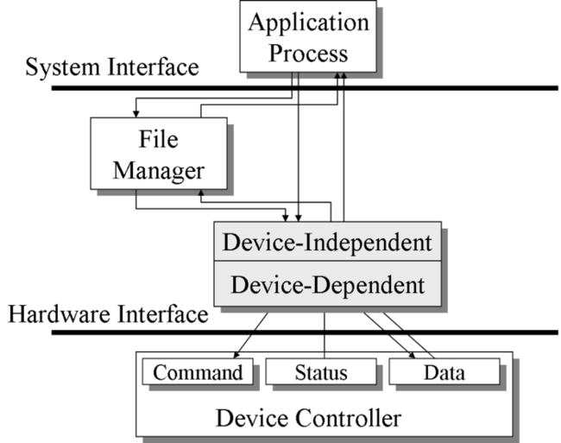
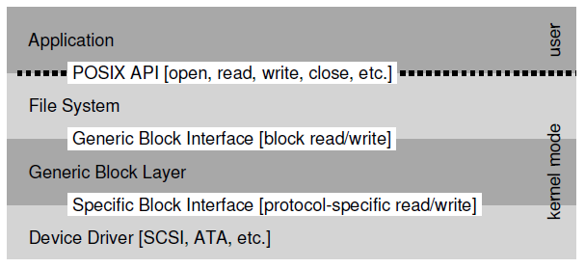
Device Driver

Slide 8
XV6 – (Integrated Drive Electronics) IDE Driver

Slide 9
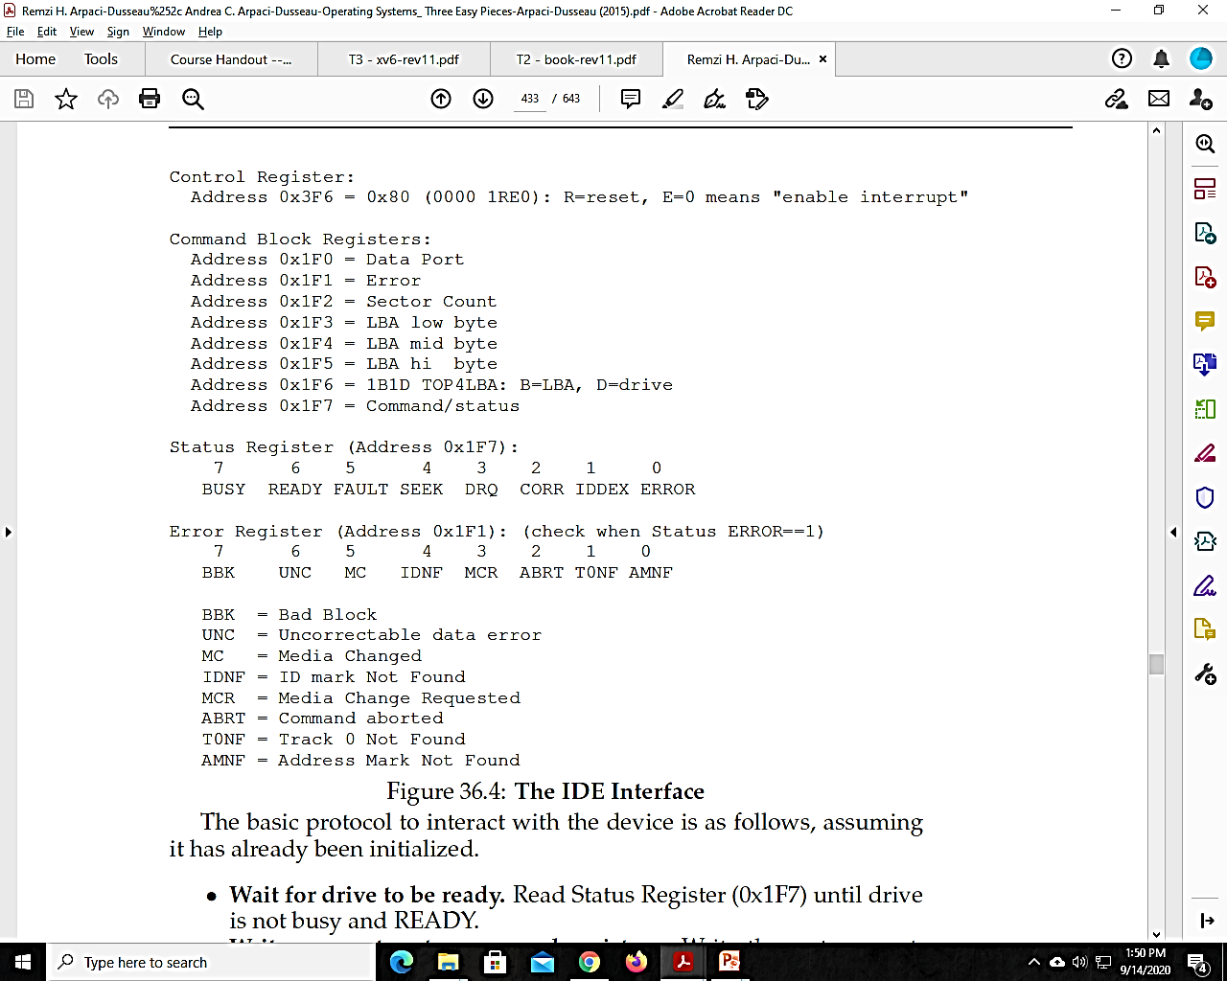
IDE Disk Driver
An IDE disk presents a simple interface to the system, consisting of four types of registers

Slide 10
IDE Disk Driver
Wait for drive to be ready: Read Status Register (0x1F7) until drive is not busy and READY.
Write parameters to command registers: Write the sector count, logical block address (LBA) of the sectors to be accessed, and drive number (master=0x00 or slave=0x10, as IDE permits just two drives) to command registers (0x1F2-0x1F6).
Start the I/O: by issuing read/write to command register. Write READ—WRITE command to command register (0x1F7).
Data transfer (for writes): Wait until drive status is READY and DRQ (drive request for data); write data to data port.
Handle interrupts: In the simplest case, handle an interrupt for each sector transferred; more complex approaches allow batching and thus one final interrupt when the entire transfer is complete.
Error handling: After each operation, read the status register. If the ERROR bit is on, read the error register for details.

Slide 11
Kernel main function Checks for IDE Disk
4250 void
4251 ideinit(void)
4252 {
4253 int i;
4254
4255 initlock(&idelock, "ide");
4256 ioapicenable(IRQ_IDE, ncpu − 1);
4257 idewait(0);
4258
4259 // Check if disk 1 is present
4260 outb(0x1f6, 0xe0 | (1<<4));
4261 for(i=0; i<1000; i++){
4262 if(inb(0x1f7) != 0){
4263 havedisk1 = 1;
4264 break;
4265 }
4266 }
4267
4268 // Switch back to disk 0.
4269 outb(0x1f6, 0xe0 | (0<<4));
4270 }
1232 ideinit(); // disk
Ideinit calls ioapicenable to enable the IDE_IRQ interrupt.
The call to ioapicenable enables the interrupt only on the last CPU (ncpu-1): on a twoprocessor system, CPU 1 handles disk interrupts.
Idewait (4238) polls the status bits until the busy bit (IDE_BSY) is clear and the ready bit (IDE_DRDY) is set.
Check for Disk 1: It writes to I/O port 0x1f6 to select disk 1 and then waits a while for the status bit to show that the disk is ready (4259-4266). If not, ideinit assumes the disk is absent.
Switch to disk 0

Slide 12
Xv6 represent file system blocks using struct buf
BSIZE (4055) is identical to the IDE’s sector size and thus each buffer represents the contents of one sector on a particular disk device.
The dev and sector fields give the device and sector number and the data field is an in-memory copy of the disk sector.
The flags track the relationship between memory and disk:
the B_VALID flag means that data has been read in, and the B_DIRTY flag means that data needs to be written out.
3850 struct buf {
3851 int flags;
3852 uint dev;
3853 uint blockno;
3854 struct sleeplock lock;
3855 uint refcnt;
3856 struct buf *prev; // LRU cache list
3857 struct buf *next;
3858 struct buf *qnext; // disk queue
3859 uchar data[BSIZE];
3860 };
3861 #define B_VALID 0x2 // buffer has been read from disk
3862 #define B_DIRTY 0x4 // buffer needs to be written to disk
4054 #define ROOTINO 1 // root i−number
4055 #define BSIZE 512 // block size

Slide 13
iderw
4350 // Sync buf with disk.
4351 // If B_DIRTY is set, write buf to disk, clear B_DIRTY, set B_VALID.
4352 // Else if B_VALID is not set, read buf from disk, set B_VALID.
4353 void
4354 iderw(struct buf *b)
4355 {
4356 struct buf **pp;
4357
4358 if(!holdingsleep(&b−>lock))
4359 panic("iderw: buf not locked");
4360 if((b−>flags & (B_VALID|B_DIRTY)) == B_VALID)
4361 panic("iderw: nothing to do");
4362 if(b−>dev != 0 && !havedisk1)
4363 panic("iderw: ide disk 1 not present");
4364
4365 acquire(&idelock);
// If buffer is not locked by the process
// If both B_DIRTY and B_VALID are set then invalid
// If it tries to write to device 1 and if device is not present

Slide 14
iderw
4367 // Append b to idequeue.
4368 b−>qnext = 0;
4369 for(pp=&idequeue; *pp; pp=&(*pp)−>qnext)
4370 ;
4371 *pp = b;
4372
4373 // Start disk if necessary.
4374 if(idequeue == b)
4375 idestart(b);
4376
4377 // Wait for request to finish.
4378 while((b−>flags & (B_VALID|B_DIRTY)) != B_VALID){
4379 sleep(b, &idelock);
4380 }
4381
4382
4383 release(&idelock);
4384 }
// adds the buffer b to the end of the queue
If the buffer is at the front of the queue, iderw must send it to the disk hardware by calling idestart; otherwise the buffer will be started once the buffers ahead of it are taken care of.
The function idestart starts a new disk request —the required information to start the operation (block number, read/write instructions) are all provided to the driver. The process calling idestart will eventually sleep waiting for the operation to finish.
iderw yields the CPU for other processes by sleeping, waiting for the interrupt handler to record in the buffer’s flags that the operation is done.
the disk will finish its operation and trigger an interrupt. trap will call ideintr to handle it

Slide 15
4272 // Start the request for b. Caller must hold idelock.
4273 static void
4274 idestart(struct buf *b)
4275 {
4276 if(b == 0)
4277 panic("idestart");
4278 if(b−>blockno >= FSSIZE)
4279 panic("incorrect blockno");
4280 int sector_per_block = BSIZE/SECTOR_SIZE;
4281 int sector = b−>blockno * sector_per_block;
4282 int read_cmd = (sector_per_block == 1) ? IDE_CMD_READ : IDE_CMD_RDMUL;
4283 int write_cmd = (sector_per_block == 1) ? IDE_CMD_WRITE : IDE_CMD_WRMUL;
4284
4285 if (sector_per_block > 7) panic("idestart");
4286
4287 idewait(0);
4288 outb(0x3f6, 0); // generate interrupt
4289 outb(0x1f2, sector_per_block); // number of sectors
4290 outb(0x1f3, sector & 0xff);
4291 outb(0x1f4, (sector >> 8) & 0xff);
4292 outb(0x1f5, (sector >> 16) & 0xff);
4293 outb(0x1f6, 0xe0 | ((b−>dev&1)<<4) | ((sector>>24)&0x0f));
idestart
0x1F2 – Sectors
0x1F3 through 0x1F6 –
offset only 8 bits
0x1F7 - status register – 1 for write
idestart moves the data to a buffer in the disk controller using the outsl instruction
4294 if(b−>flags & B_DIRTY){
4295 outb(0x1f7, write_cmd);
4296 outsl(0x1f0, b−>data, BSIZE/4);
4297 } else {
4298 outb(0x1f7, read_cmd);
4299 }

Slide 16
Interrupt handler
4302 // Interrupt handler.
4303 void
4304 ideintr(void)
4305 {
4306 struct buf *b;
4307
4308 // First queued buffer is the active request.
4309 acquire(&idelock);
4310
4311 if((b = idequeue) == 0){
4312 release(&idelock);
4313 return;
4314 }
4315 idequeue = b−>qnext;
4316
4317 // Read data if needed.
4318 if(!(b−>flags & B_DIRTY) && idewait(1) >= 0)
4319 insl(0x1f0, b−>data, BSIZE/4);
4320
4321 // Wake process waiting for this buf.
4322 b−>flags |= B_VALID;
4323 b−>flags &= ~B_DIRTY;
4324 wakeup(b);
4325
4326 // Start disk on next buf in queue.
4327 if(idequeue != 0)
4328 idestart(idequeue);
4329
4330 release(&idelock);
4331 }
Now the buffer is ready: ideintr sets B_VALID, clears B_DIRTY, and wakes up any process sleeping on the buffer
ideintr must pass the next waiting buffer to the disk
consults the first buffer in the queue to find out which operation was happening.
If the buffer was being read and the disk controller has data waiting, ideintr reads the data from a buffer in the disk controller into memory with insl

